Slide 1
Project 1 – Exploring Uber Data
The A Team

Slide 2
Project Outline
Why Uber
Uber has become the most popular choice for travel across the world.
In 2021, there were 118 million users in over 80 countries.
Exploration of Uber data in New York between 2009 and 2014.
Exploration of the consumer behaviour.

Slide 3
The Questions
Does the time/date affect how often people order Uber’s?
How has Uber prices changed over time?
What distance are people using Uber’s for?
What are the most common amount of passengers for an Uber

Slide 4

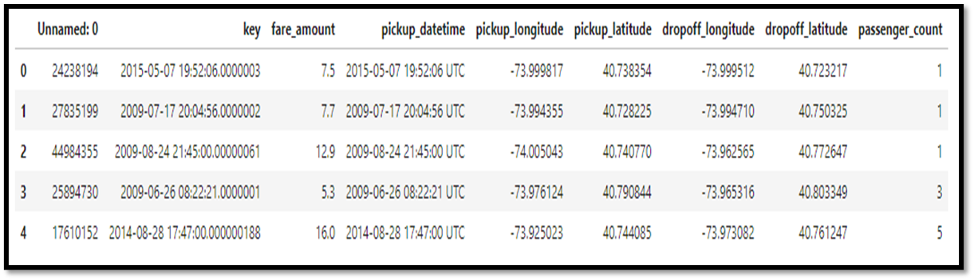
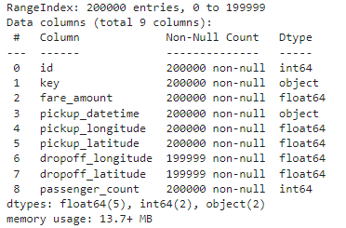
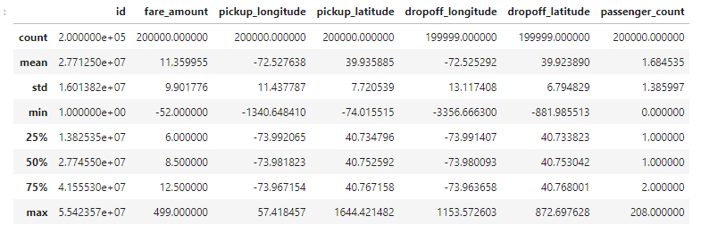
Data Exploration
Uber Data – csv file
Uber trips in New York 2009 - 2015
Kaggle Dataset - Uber Fares Dataset | Kaggle

Slide 5
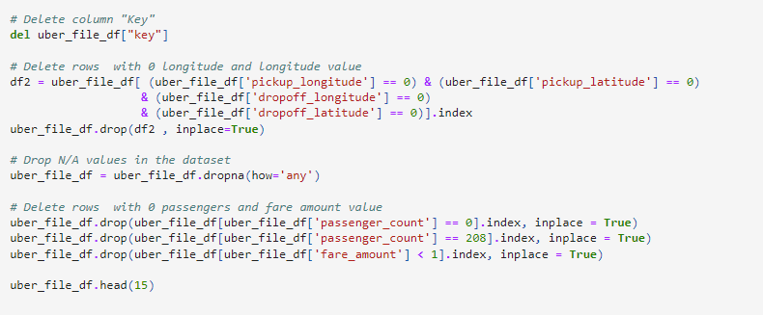
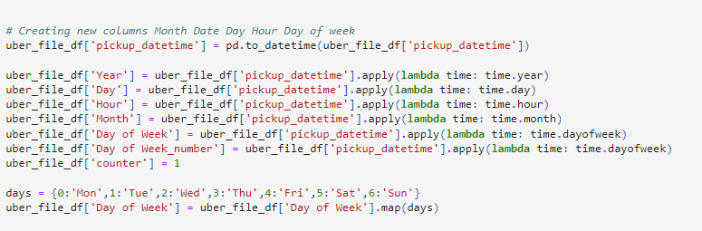

Clean-up process
Dropped rows with N/A and extreme values in passenger count, distance and coordinators.
Changed pickup_datetime column to year, month, day, hours.
Deleted un-necessary columns

Slide 6
Analysis Process

Slide 7
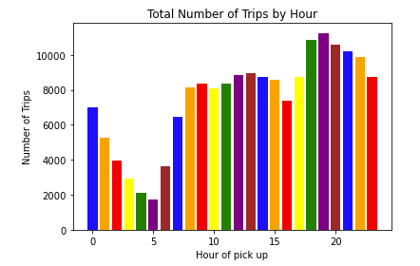
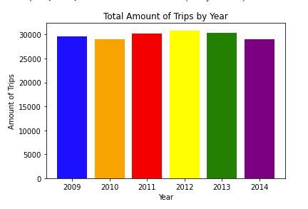
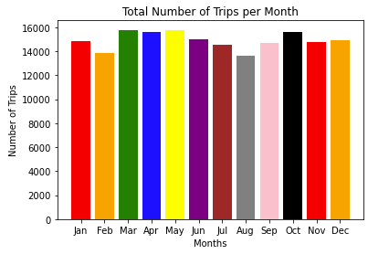
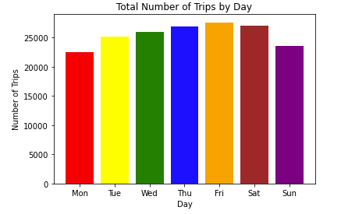
Time/Date

Slide 8
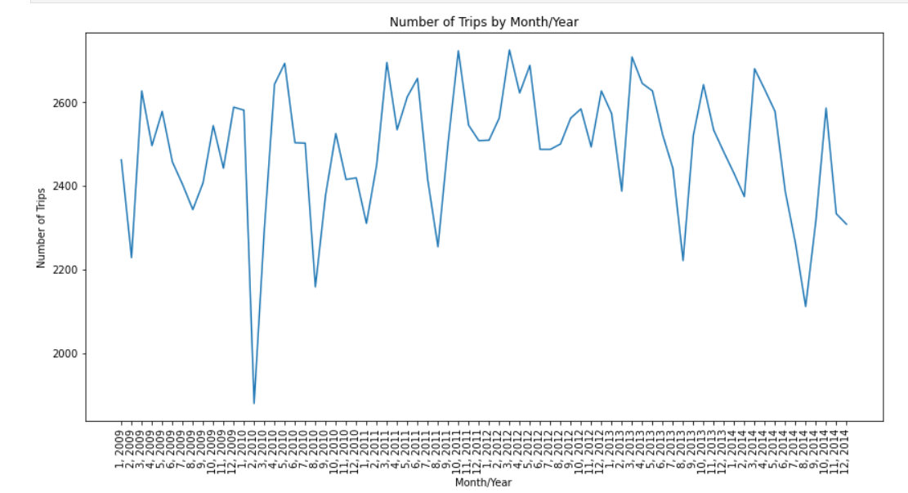

Extreme Weather event

Slide 9
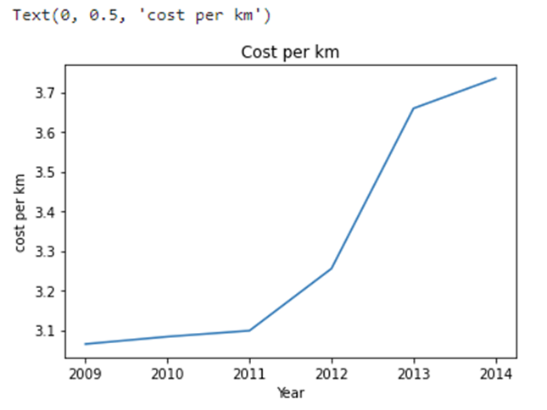
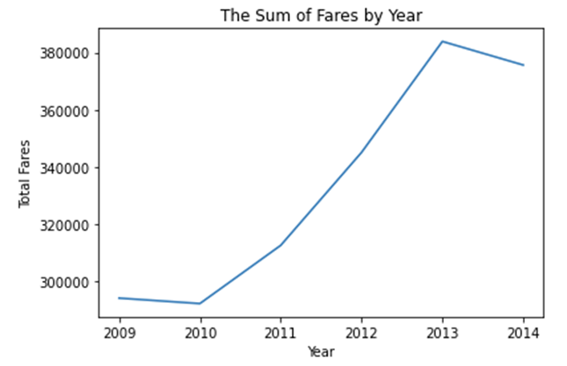
Cost

Slide 10
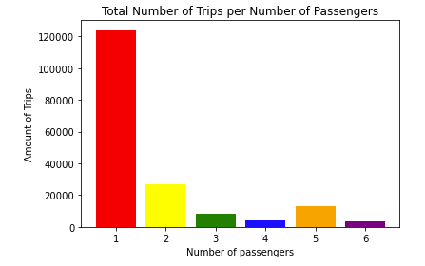
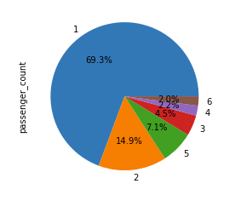
Number of Passengers
Our data shows that people often take uber trips on their own

Slide 11
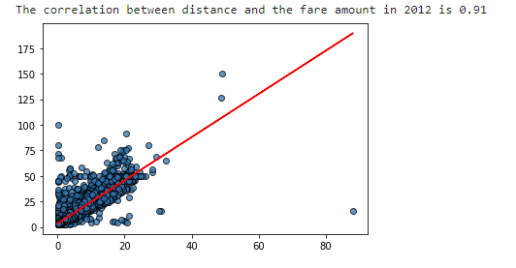
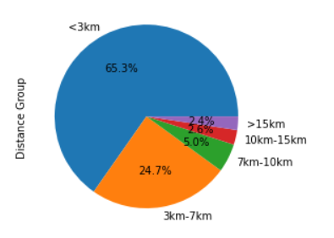
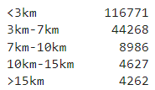
Distance
Our data shows that people mainly use Uber for short trips.
Over 65% of the trips we analyzed were less than 3km in distance
Nearly 25% were between 3km and 7km in distance
There’s a very strong positive correlation between the distance and fare amount

Slide 12
Final Dataframes

Slide 13
Conclusions and Implications

